Slide 1
Gender Recognition by Voice
Fall 2017 CSC 560 1 Data Science
Final Presentation
Aradhana Nair, Namrata Biswas, Swarnam Dash
12/14/2017

Slide 2
Agenda
Introduction
The dataset
Project goals
Data Visualization
Modelling
Analysis
Conclusion
Reference

Slide 3
Introduction
This database was created to identify a voice as male or female, based upon acoustic properties of the voice and speech.
Consists of 3,168 recorded voice samples, collected from male and female speakers.
Voice samples are pre-processed by acoustic analysis in R using the seewave and tuneR packages, with an analyzed frequency range of 0hz-280hz (human vocal range).

Slide 4
The dataset
Acoustic properties of each voice are measured and included within the CSV:
Feature | Definition | Feature | Definition
meanfreq | mean frequency (in kHz) | kurt | kurtosis
sd: | standard deviation of frequency | sp.ent | spectral entropy
median: | median frequency (in kHz) | sfm | spectral flatness
Q25 | first quartile (in kHz) | mode | mode frequency
Q75 | third quartile (in kHz) | centroid | frequency centroid
IQR | interquartile range (in kHz) | peakf | peak frequency
skew: | skewness | meanfun | average of fundamental frequency measured across acoustic signal

Slide 5
The dataset
Acoustic properties of each voice are measured and included within the CSV:
Feature | Definition | Feature | Definition
minfun | minimum fundamental frequency measured across acoustic signal | maxdom | maximum of dominant frequency measured across acoustic signal
maxfun: | maximum fundamental frequency measured across acoustic signal | dfrange | range of dominant frequency measured across acoustic signal
meandom | average of dominant frequency measured across acoustic signal | modindx | modulation index. Calculated as the accumulated absolute difference between adjacent measurements of fundamental frequencies divided by the frequency range
mindom | minimum of dominant frequency measured across acoustic signal | label | male or female

Slide 6
Project goals
What are the most related features ?
What is the variation in the dataset?
How accurate is our analysis
Are there other interesting features in the data?

Slide 7

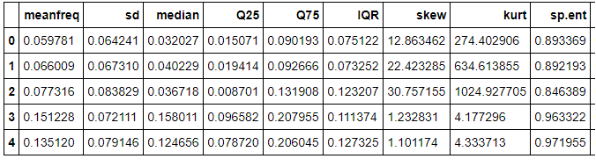

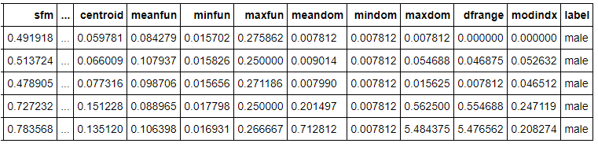
The dataset

Slide 8
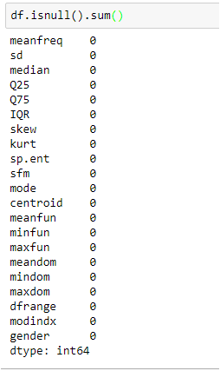
Null Values

Slide 9
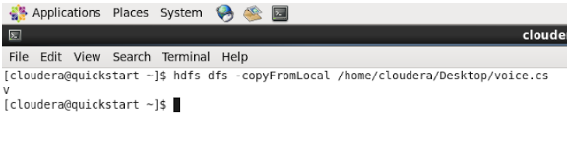
Loading data to hdfs

Slide 10
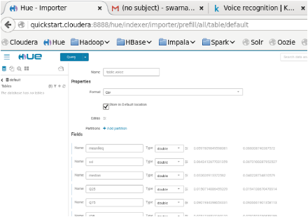
Creating table in Hive

Slide 11
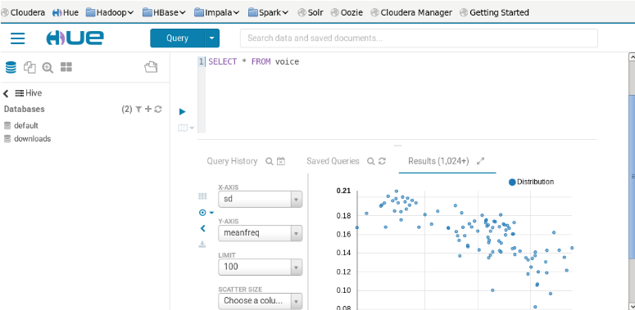
Query in Hive

Slide 12
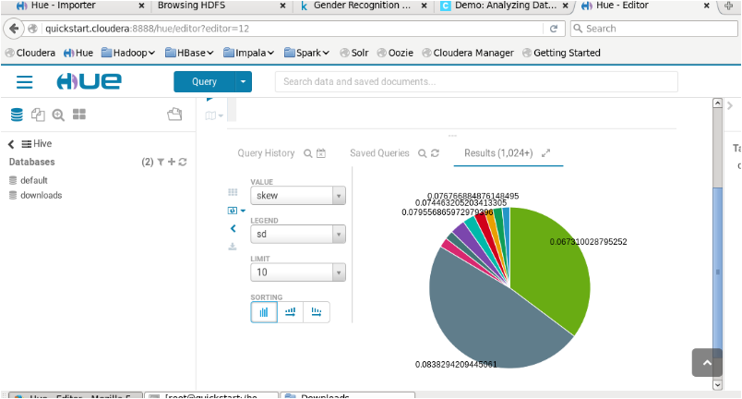
Pie chart in Hive

Slide 13

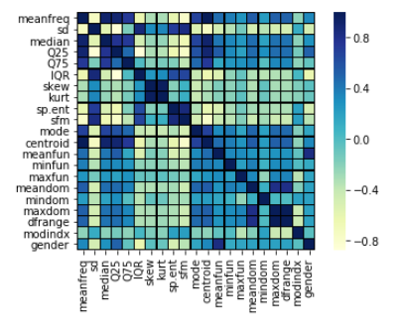

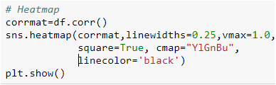
Heatmap

Slide 14
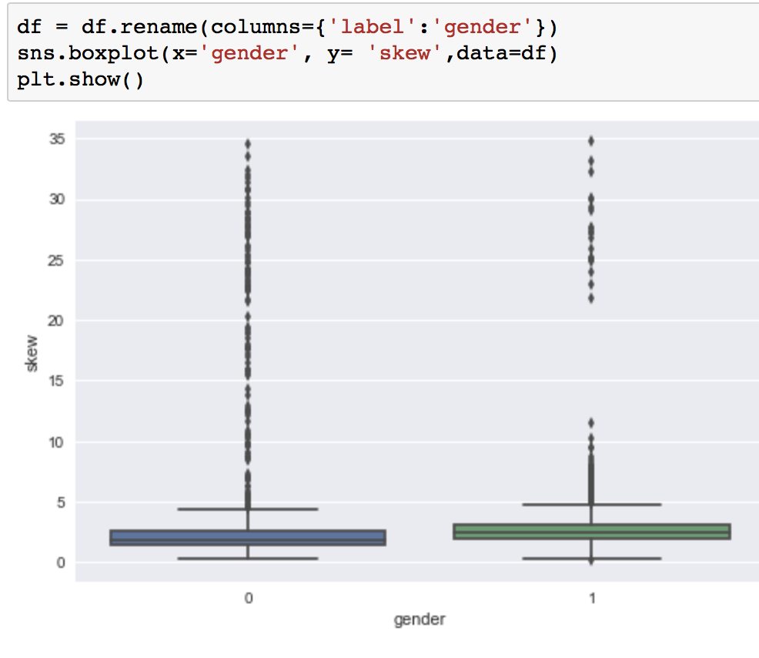
Box Plot
Graphically depicting groups of numerical data through their quartiles.
Outliers may be plotted as individual points.
Box plots are non-parametric: they display variation in samples of a statistical population without making any assumptions of the underlying statistical distribution.

Slide 15
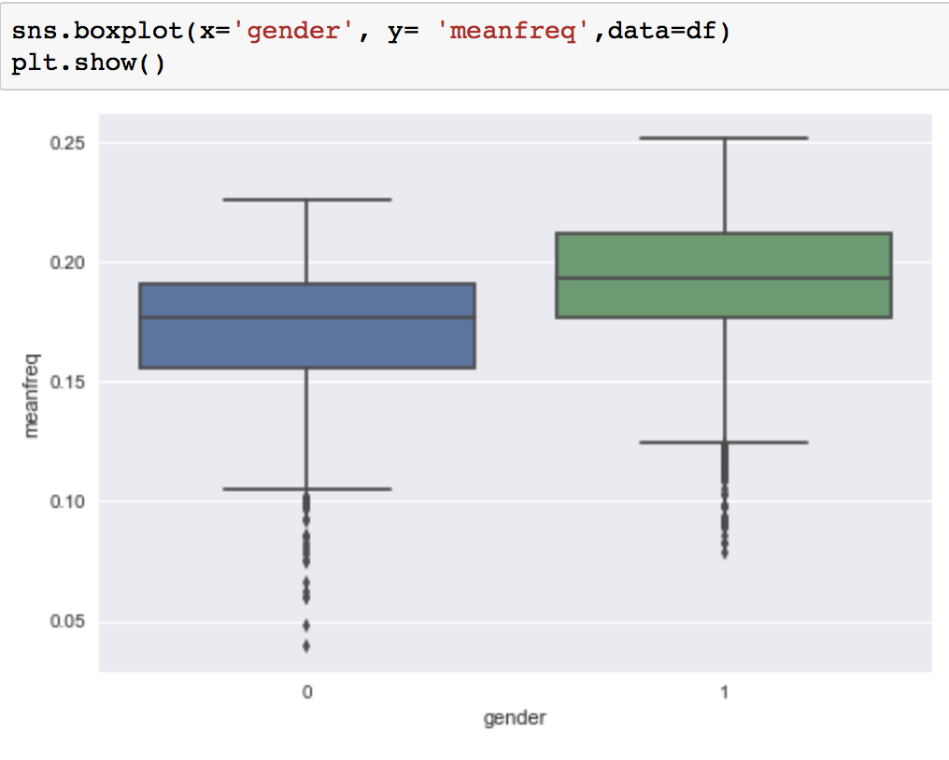
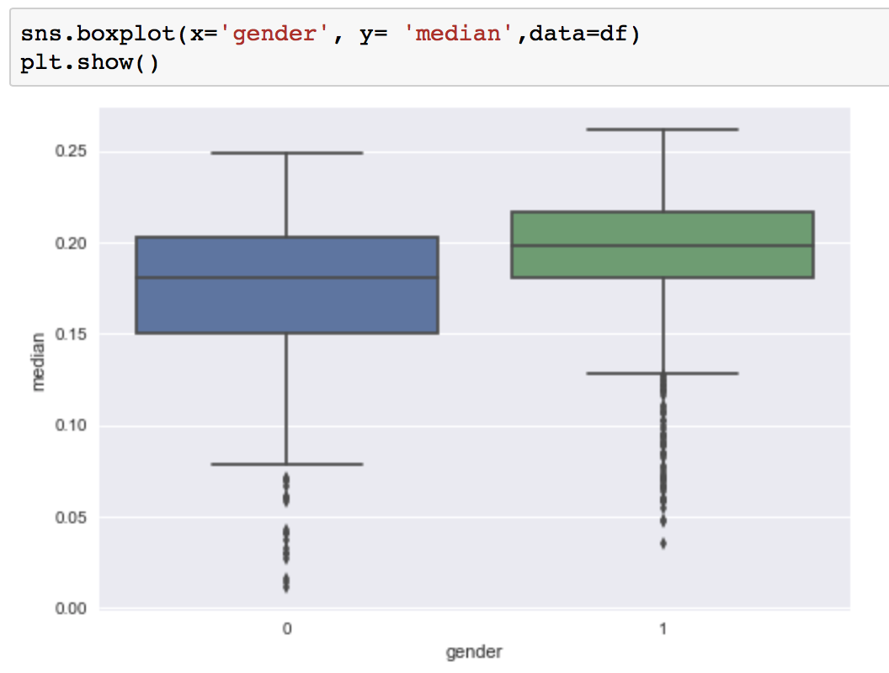
Box Plots

Slide 16
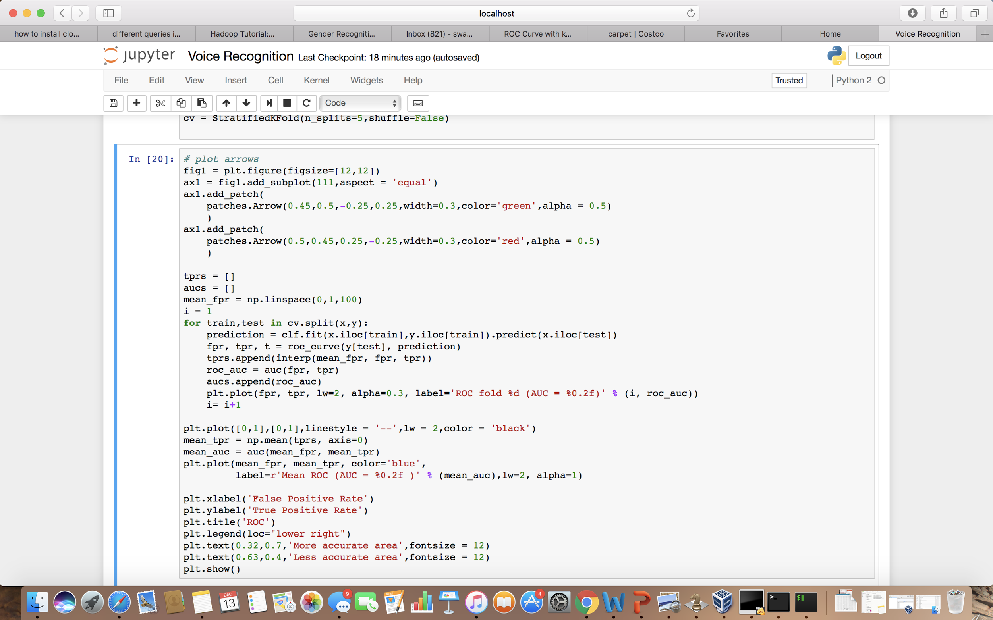
ROC Curve

Slide 17
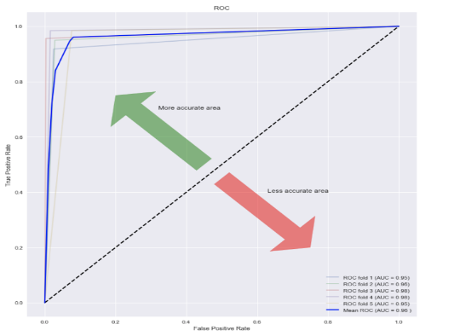
ROC Curve - Receiver Operating Characteristic
True positive rate (Sensitivity) is plotted in function of the false positive rate (100-Specificity) for different cut-off points.
Each point on the ROC curve represents a sensitivity/specificity pair corresponding to a particular decision threshold.
The closer the ROC curve is to the upper left corner, the higher the overall accuracy of the test.

Slide 18
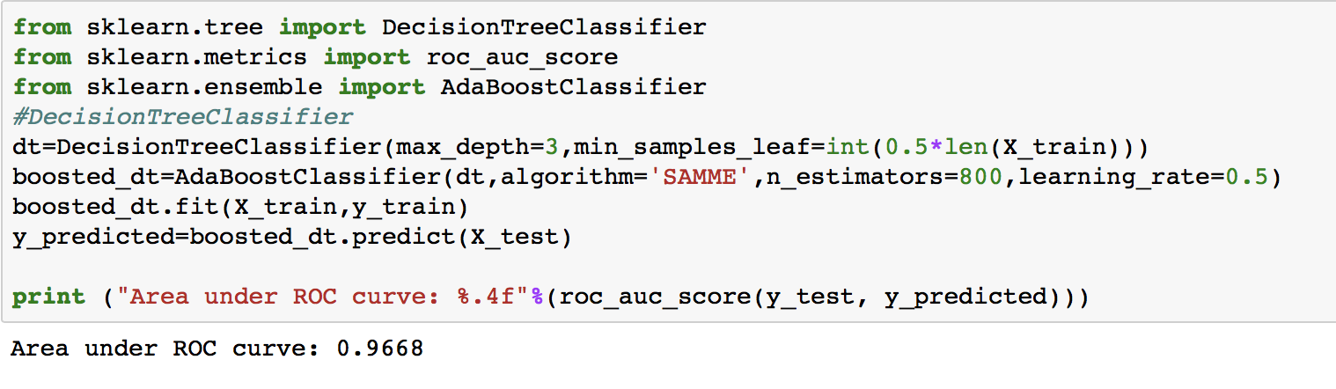
Decision Tree

Slide 19
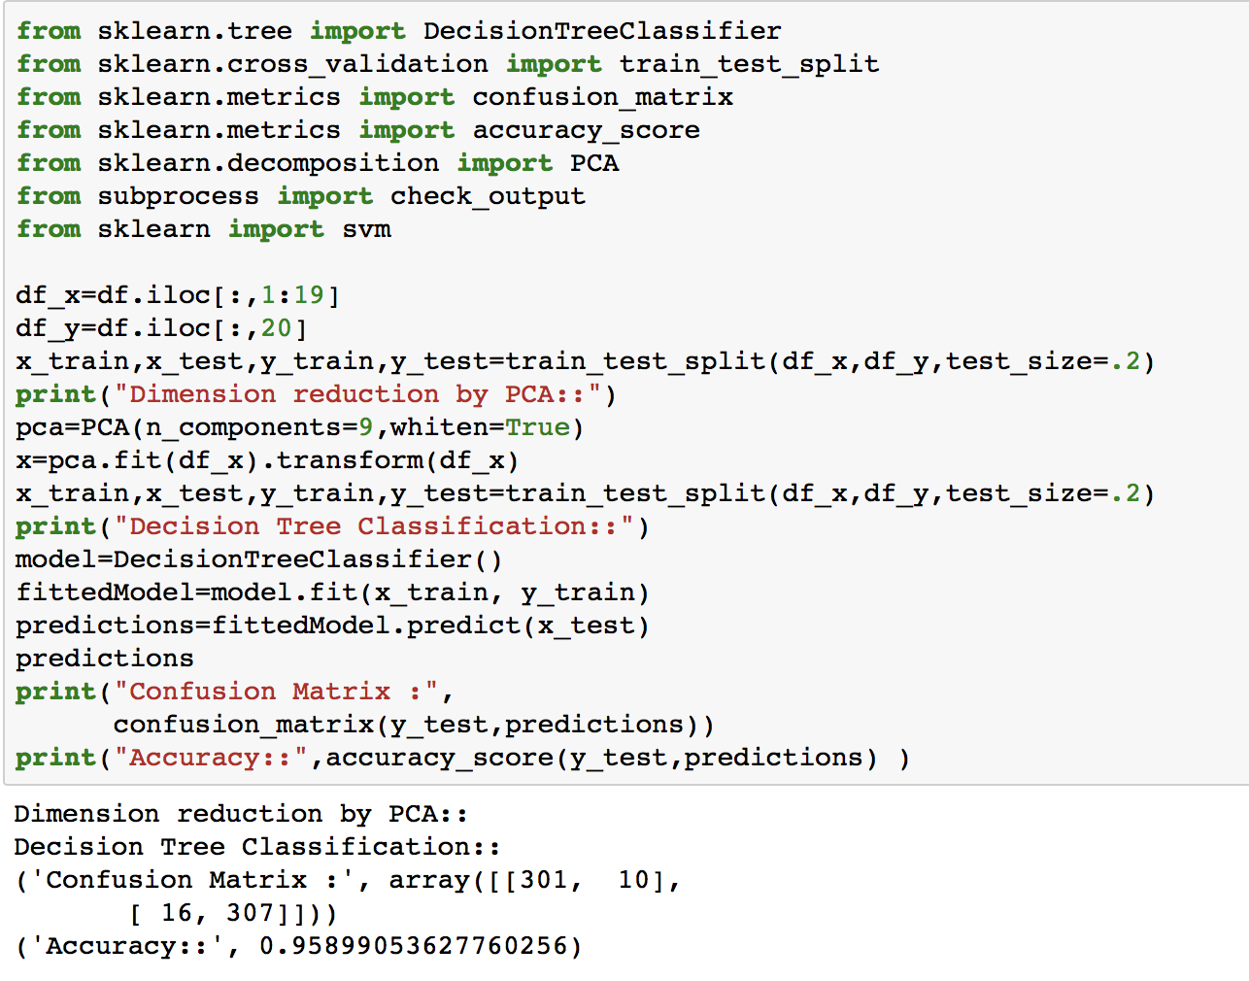
PCA - Principal component analysis

Slide 20
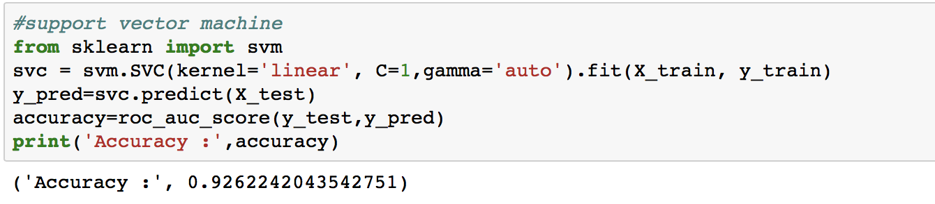
Support Vector Machine

Slide 21
Conclusion
Accuracy is good in all the classification methods which means the features which have been selected gives a good overview of the dataset.
Best classifier for male & female voice is PCA
The short-time analysis is most basic approach to obtain the required parameters for the gender classification problem.
In the slides, it shows we can use acoustic properties of the voices and speech to detect the voice gender.

Slide 22
References
https://www.kaggle.com/
http://scikit-learn.org/stable/auto_examples/ensemble/plot_adaboost_regression.html
http://scikit-learn.org/stable/modules/generated/sklearn.decomposition.PCA.html
http://scikit-learn.org/stable/modules/generated/sklearn.svm.SVC.html

Slide 23
Thank you

